Slide 1
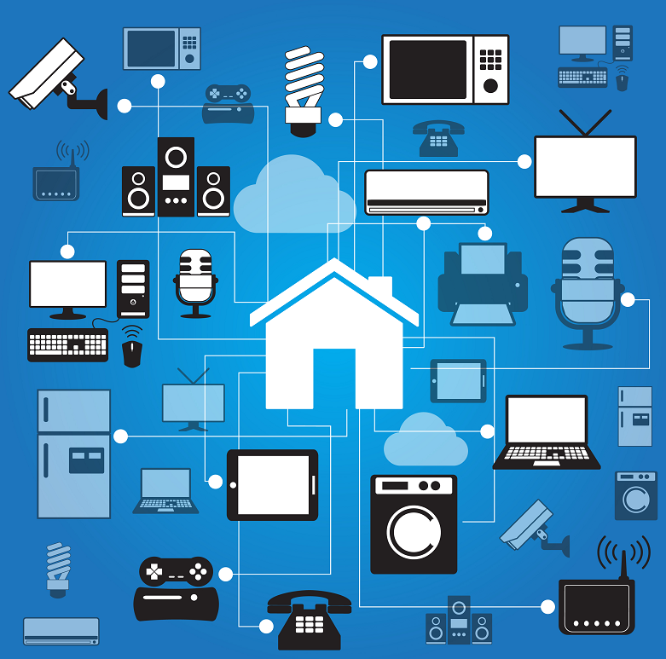
Gyan Ganga Institute of Technology and Sciences
Home Automation using Arduino
Mentor- Professor Udit Narayan Bera

Slide 2
Presented By
Raunak Jain
Tanmay Agrawal
Priyanshi Agrawal
Rupali Choudhary
Shakaina Naranje
Sudhanshu Shekhar
Shubhi Khare

Slide 3
HOME AUTOMATION USING ARDUINO

Slide 4







APPLICATIONS
Secure Gate
Bluetooth Control Lights
Fire Control
Temperature Display [using LCD]
Automatic Light Control
Rain Sensor
Gas Leakage Detection

Slide 5
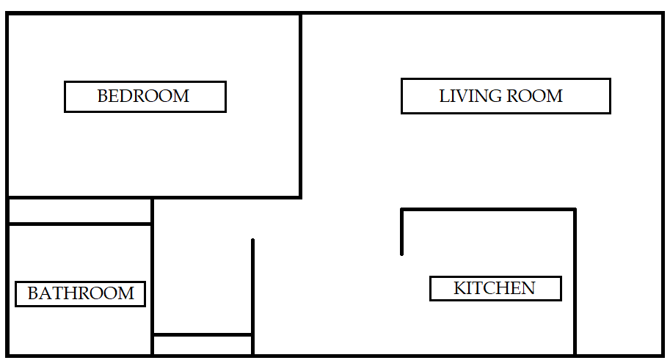

BASIC LAYOUT

Slide 6

AUTOMATIC CONTROL LIGHTS
1.Arduino UNO
2.Alphanumeric LCD, 16*2
4.Ultrasonic Sensor, HC – SR04 (Generic)
5.Solderless Breadboard Full Size
6.Female Jumper Wires
7.Male Jumper Wires
8.LED light Bulb

Slide 7
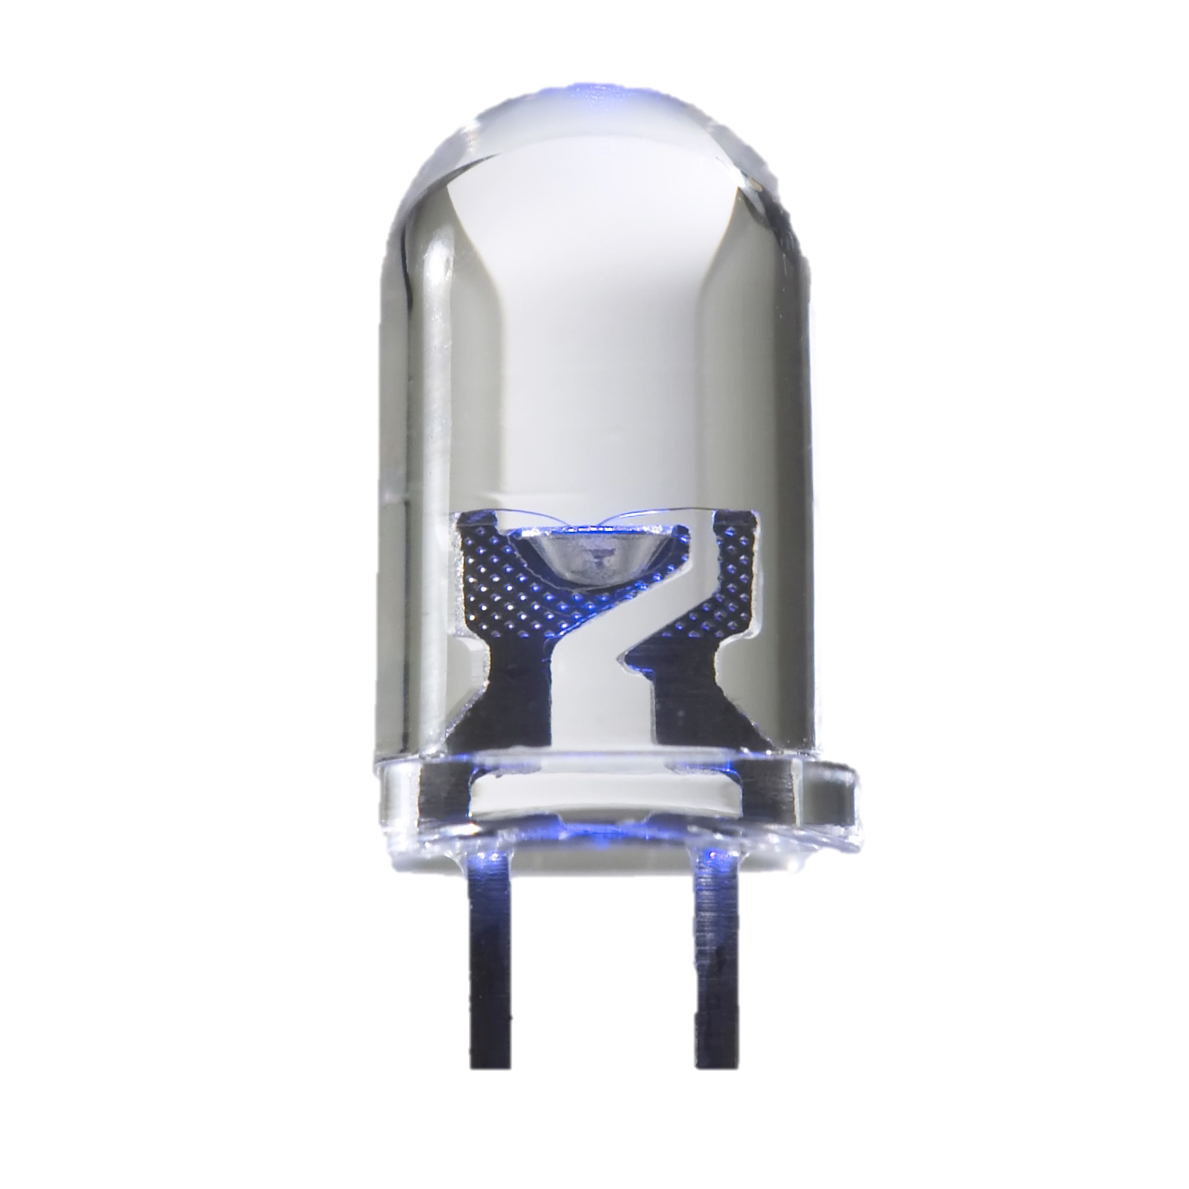
FIRE CONTROL
Arduino
Fire Sensor
Jumper Wires
LED
Buzzer

Slide 8

TEMPERATURE DISPLAY USING LCD
Arduino UNO
LCD Screen
LM35 Temperature sensor
Jumper wires
Resistor

Slide 9
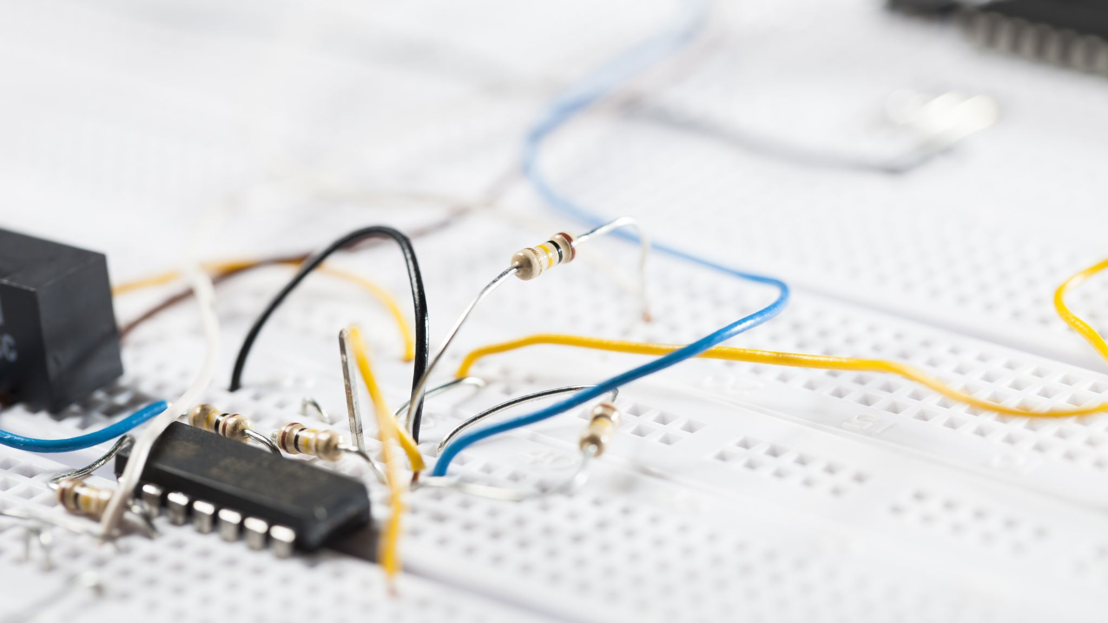
RAIN SENSOR
Arduino UNO
Rain Sensor
Breadboard
Jumper Wires
LED Bulb

Slide 10
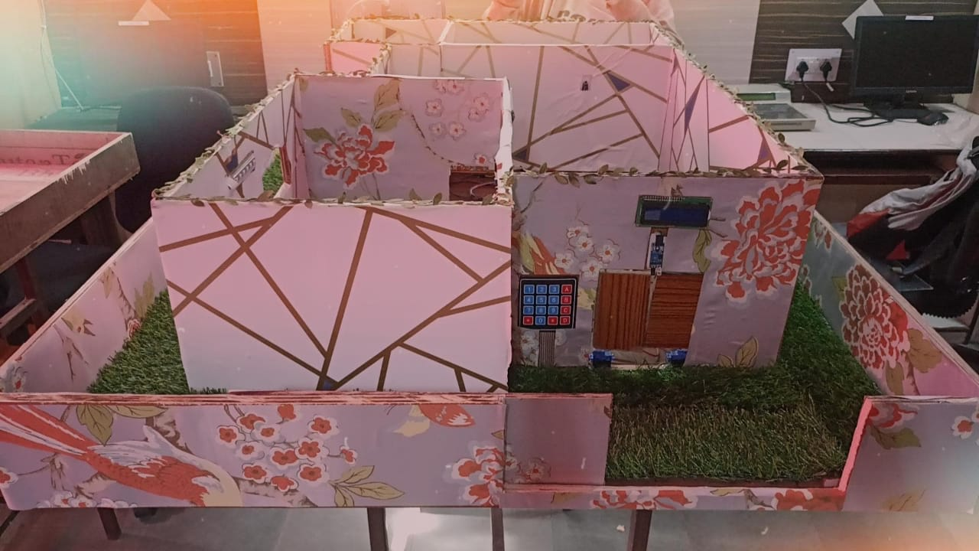
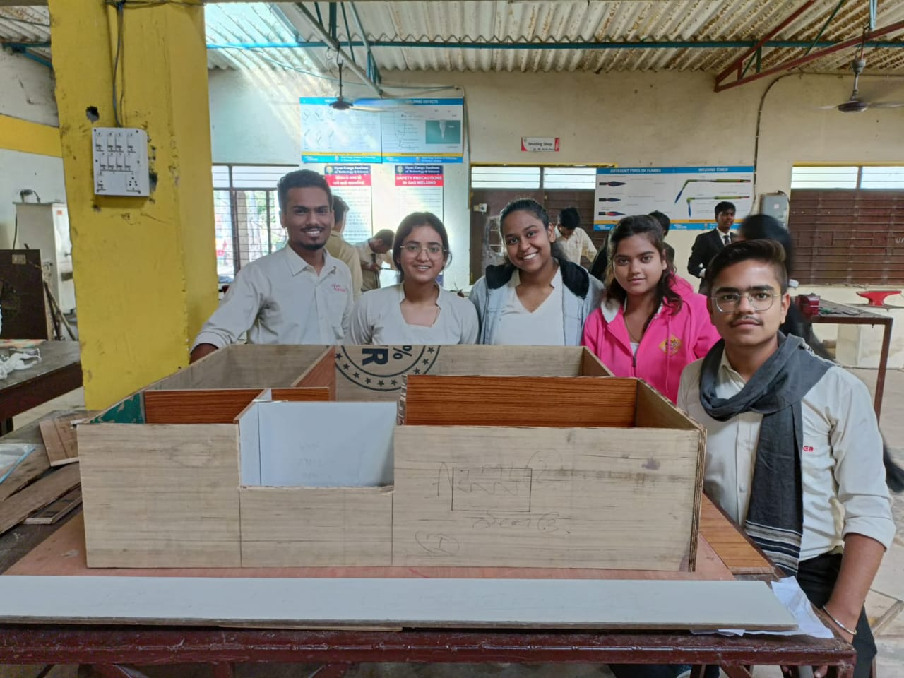
INITIAL OUTPUT
FINAL OUTPUT

Slide 11
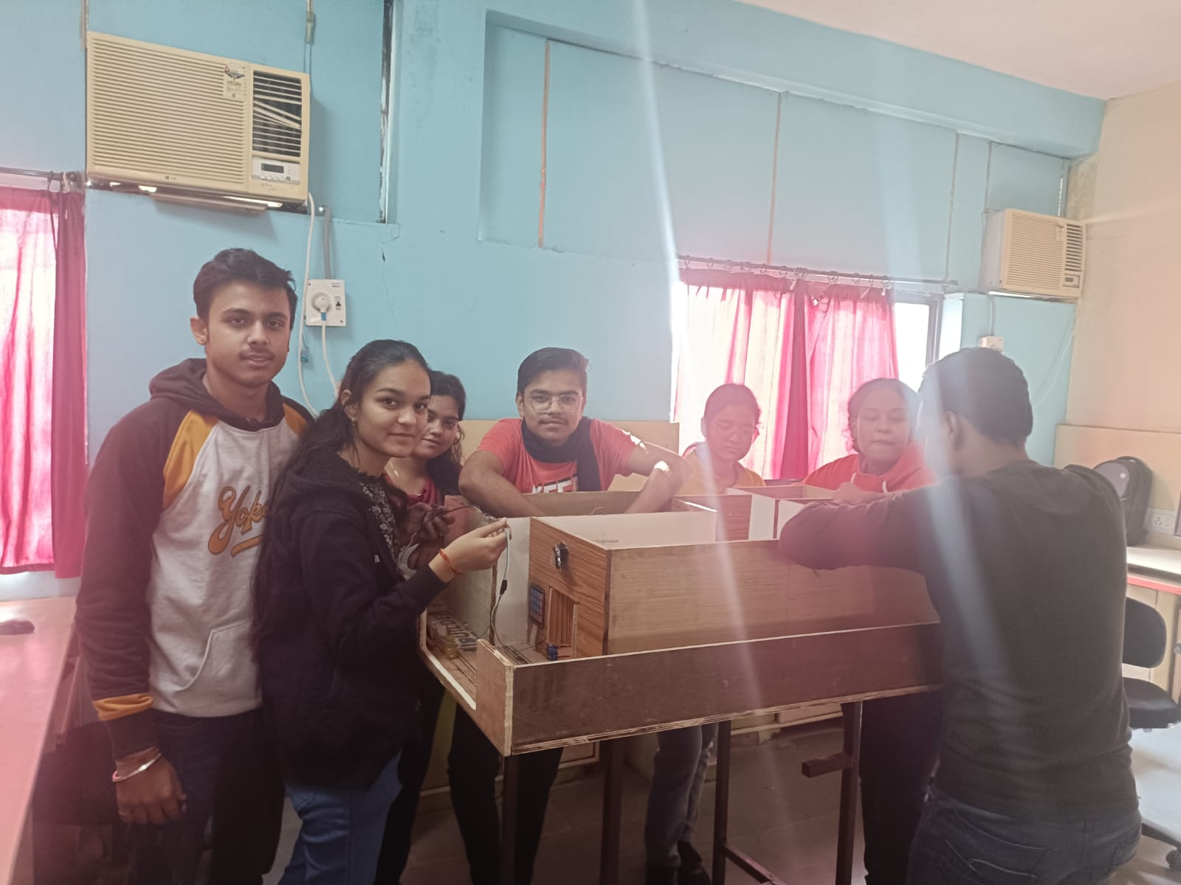

Slide 12
Cost
COST
Flame = 150 INR
Gas = 250 INR
PIR = 500 INR
BUZZER = 500 INR
Ultra sonic = 150 INR
Keypad = 400 INR
Servo motor = 15000 INR
NodeMCU = 500-1000 INR
Relay = 500 INR
Plus Arduino Mega = 2000 INR
Wires = 2000 INR
Extra expenses = 2500 INR
Total = 25000 INR

Slide 13
Thank you

